Slide 1
Project Setup
Prof. Dr. Dirk Riehle
Friedrich-Alexander University Erlangen-Nürnberg
AMOS A02
Licensed under CC BY 4.0 International

Slide 2
Agenda
Code repository
Issues
Project board
Committing code
Planning documents
Impediments backlog
Weekly checklist

Slide 3
Project Management
The AMOS Project directive is simplify, simplify, simplify!
  GitHub repository, issues, and project board for software development
  Google Sheets for high-level product and process management
  Teams may add additional tools at their discretion (and own risk)

Slide 4
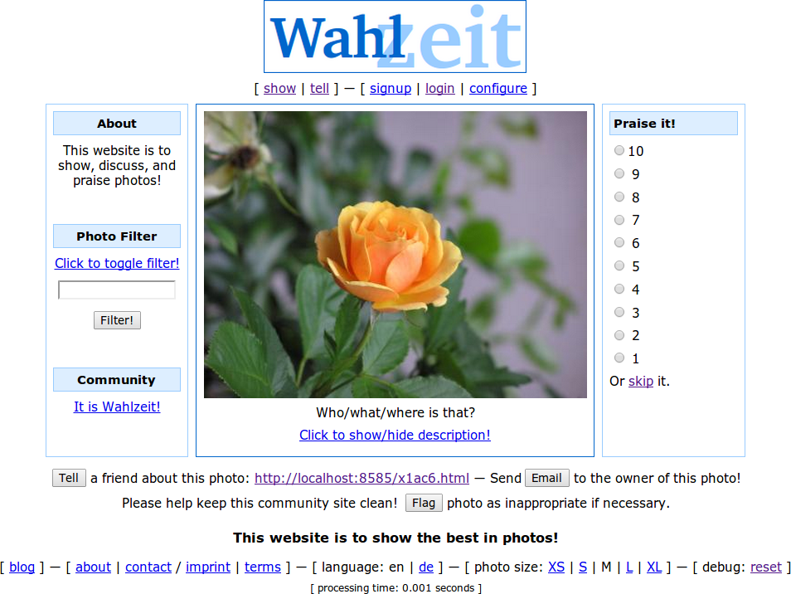
The Wahlzeit / Flowers Example

Slide 5
1. Code Repository

Slide 6
GitHub Code Repository Set-up
GitHub account
  Please create a GitHub account if you don’t have one yet
  Add your account name (handle) to planning documents
GitHub project
  We will create a team for you and invite you to a code repository
  You will all be owners of the code repository, initially; change as you see fit
Your project name will be amosproj / amos2021ws0x-fabulous-project
  It will be public (read access to world)
  It uses the MIT license
You can collaborate as you see fit (but should agree first)
  For grading, we will look at the above project

Slide 7
License and Copyright Declaration
Please use the REUSE SOFTWARE [1] format to declare license and copyright in files
// SPDX-License-Identifier: MIT
// SDPX-FileCopyrightText: 2010-2021 Dirk Riehle <dirk@riehle.org>
// SPDX-FileCopyrightText: 2019 Georg Schwarz <georg.schwarz@fau.de>
[1] See https://reuse.software/

Slide 8
2. Issues

Slide 9
Feature and User Story
Definition of feature
  A distinguishing characteristic of a software item (for example, performance, portability, functionality)
  (IEEE 829)
Definition of user story
  A description mechanism for a software feature used to create a shared understanding of the feature; follows an established pattern
  The description pattern is: As a “user role”, I need “a function”, so that “I get business value” where the parts in quotation marks are substituted
Example user stories
  Rate-a-photo: As a visitor, I can rate a photo with a numerical value 1-10, so that I can share my opinion about the photo.
  Tell-a-friend: As a user, I need a function to tell a friend about a flower photo, so that I can share my passion for flowers.

Slide 10
Types of Issues
Features
  New functional improvements
Refactorings
  Behavior-preserving improvements
Bugs
  Fixes to malfunctioning

Slide 11
Quality Criteria for Features
I | ndependent: Features should be independent of each other.
N | egotiable: A feature is man-made, not cast in stone.
V | aluable: Every feature should have business value.
E | stimatable: A feature should be precise so that size can be estimated.
S | mall: A feature should be small enough for one iteration.
T | estable: A feature should have testable success criteria.

Slide 12
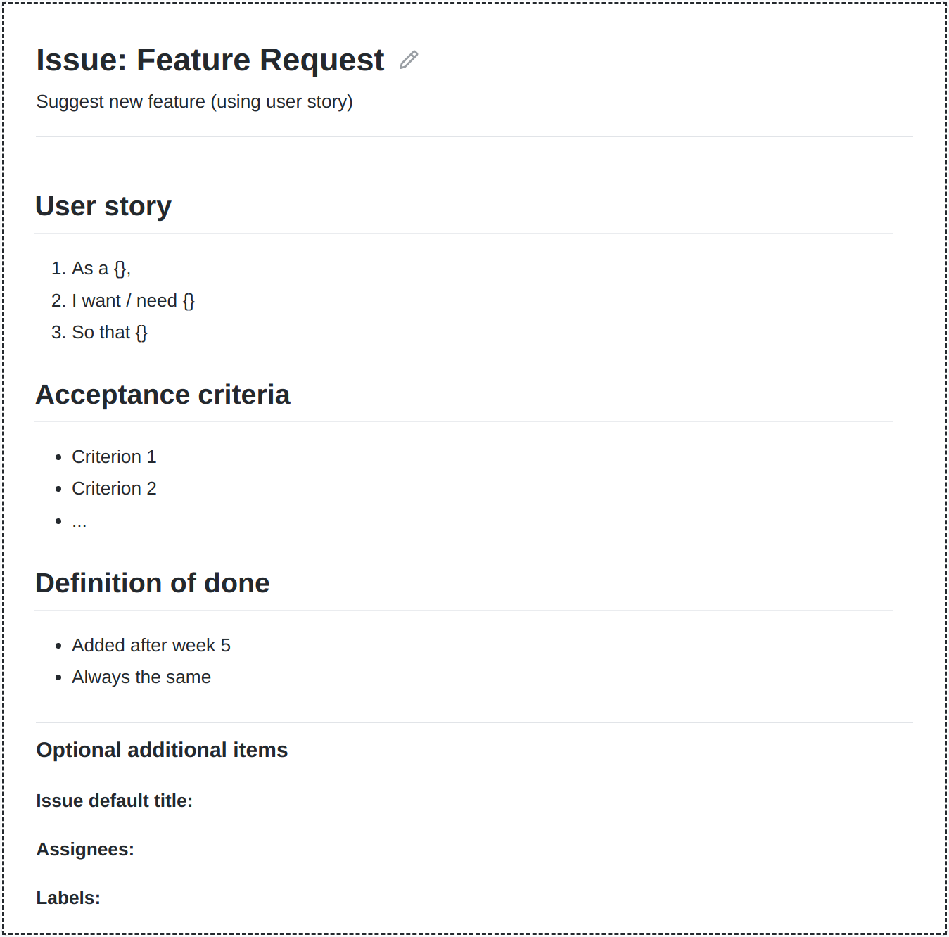
GitHub Issues Set-up
GitHub issue template
  Please create a template for feature requests
  The template should contain fields for
    Short name (already preset as title field)
    Short description (using user story)
    Acceptance criteria (to test for fulfillment)
    Definition of done (from week 5 on)
Create labels for features sizes
  Est. size = X for estimated sizes
    Set during sprint planning
  Real size = Y for actual size
    Set during sprint review
  Use escalating colors
Feel free to add more templates

Slide 13
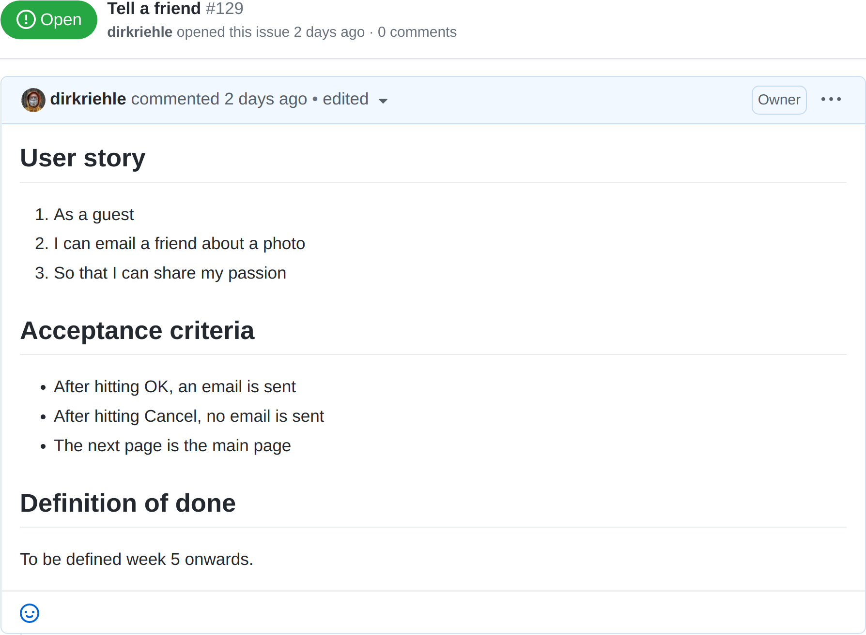
The Tell a Friend Feature 1 / 2

Slide 14
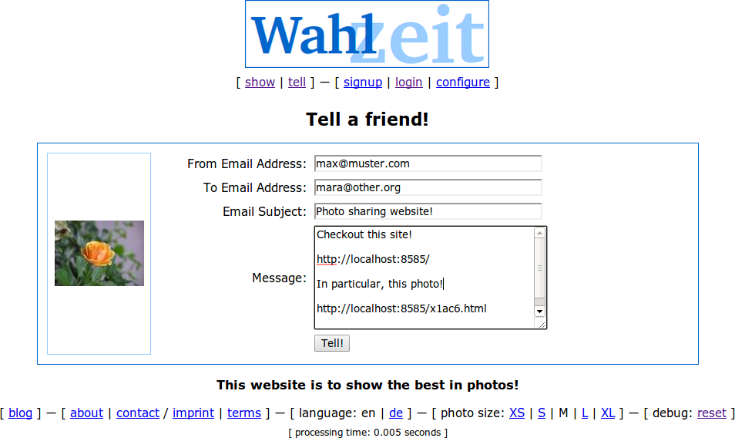
The Tell a Friend Feature 2 / 2

Slide 15
3. Project Board

Slide 16
The Feature Life-Cycle
Product Backlog
Sprint Backlog
In progress
Awaiting review
Feature Archive
2. Tell-a-friend
Est. size = 8
3. Tell-a-friend
Est. size = 8
4. Tell-a-friend
Est. size = 8
5. Tell-a-friend
Est. size = 8 Real size = 8
6. Tell-a-friend
Est. size = 8 Real size = 8
...
...
...
...
...
...
...
1. Tell-a-friend

Slide 17
Product Backlog and Product Backlog Entry
Product backlog entry
  A named, identifiable, and prioritized feature, bug, or refactoring
Product backlog
  An incomplete, evolving list of features prioritized by business value
Purpose of product backlog
  To know what’s coming up next

Slide 18
Sprint Backlog and Sprint Backlog Entry
Sprint backlog entry
  A high-quality product backlog entry that
    has been estimated for size and committed-to to being implemented by the software developers
Sprint backlog
  A list of sprint backlog entries that
    the software developers have committed to implementing in the current sprint
Purpose of sprint backlog
  To know at any time what to do in the current sprint
  To serve for task allocation between developers

Slide 19
Feature Archive
Feature archive
  All issues that have been implemented
  All issues contain the original size estimation
  All issues contain the real (after-implementation) size
Purpose of feature archive
  To serve as a summary of product features
  To allow lookup of history of development

Slide 20
GitHub Project Set-up
GitHub project
  Please create a project (board) for backlogs
  The board should have five columns
    Product backlog (for new unscheduled features)
    Sprint backlog (for features to-be-done)
    In progress (for features currently in work)
    Awaiting review (for features to be reviewed)
    Feature archive (for finished features)
Connect issues with project

Slide 21
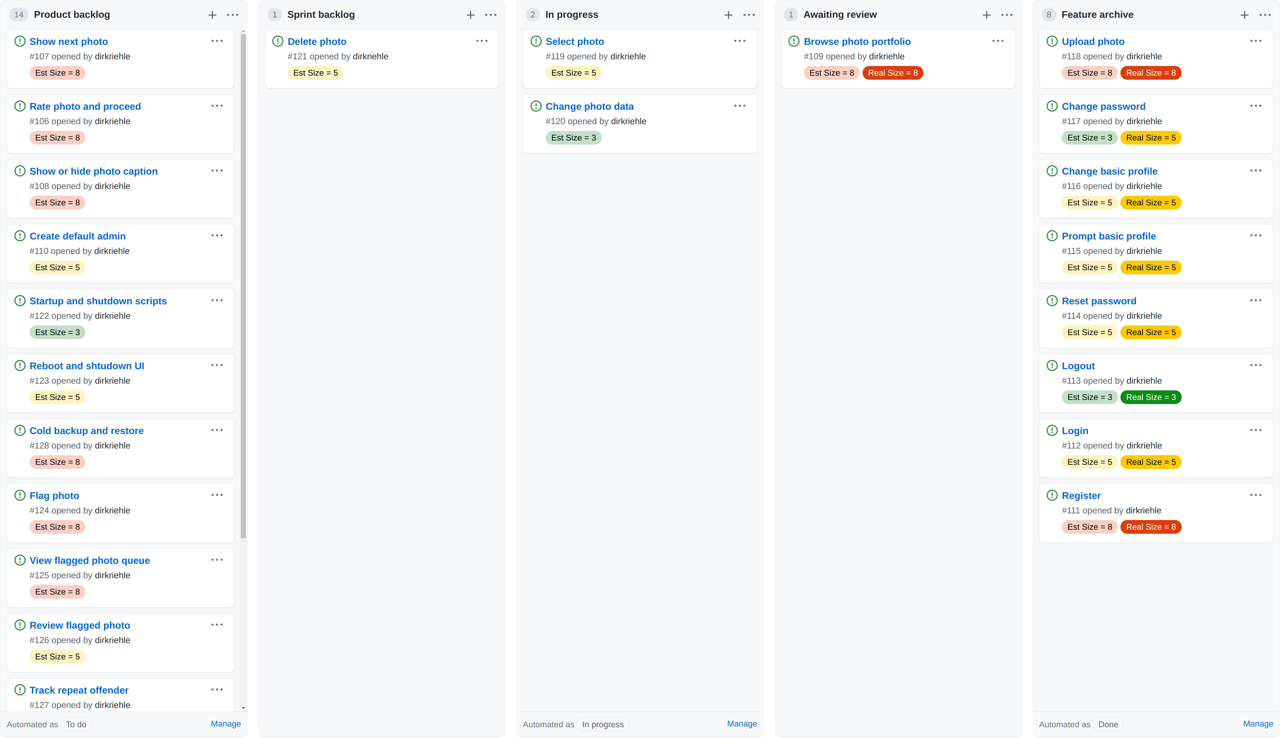
The Wahlzeit / Flowers Project Board

Slide 22
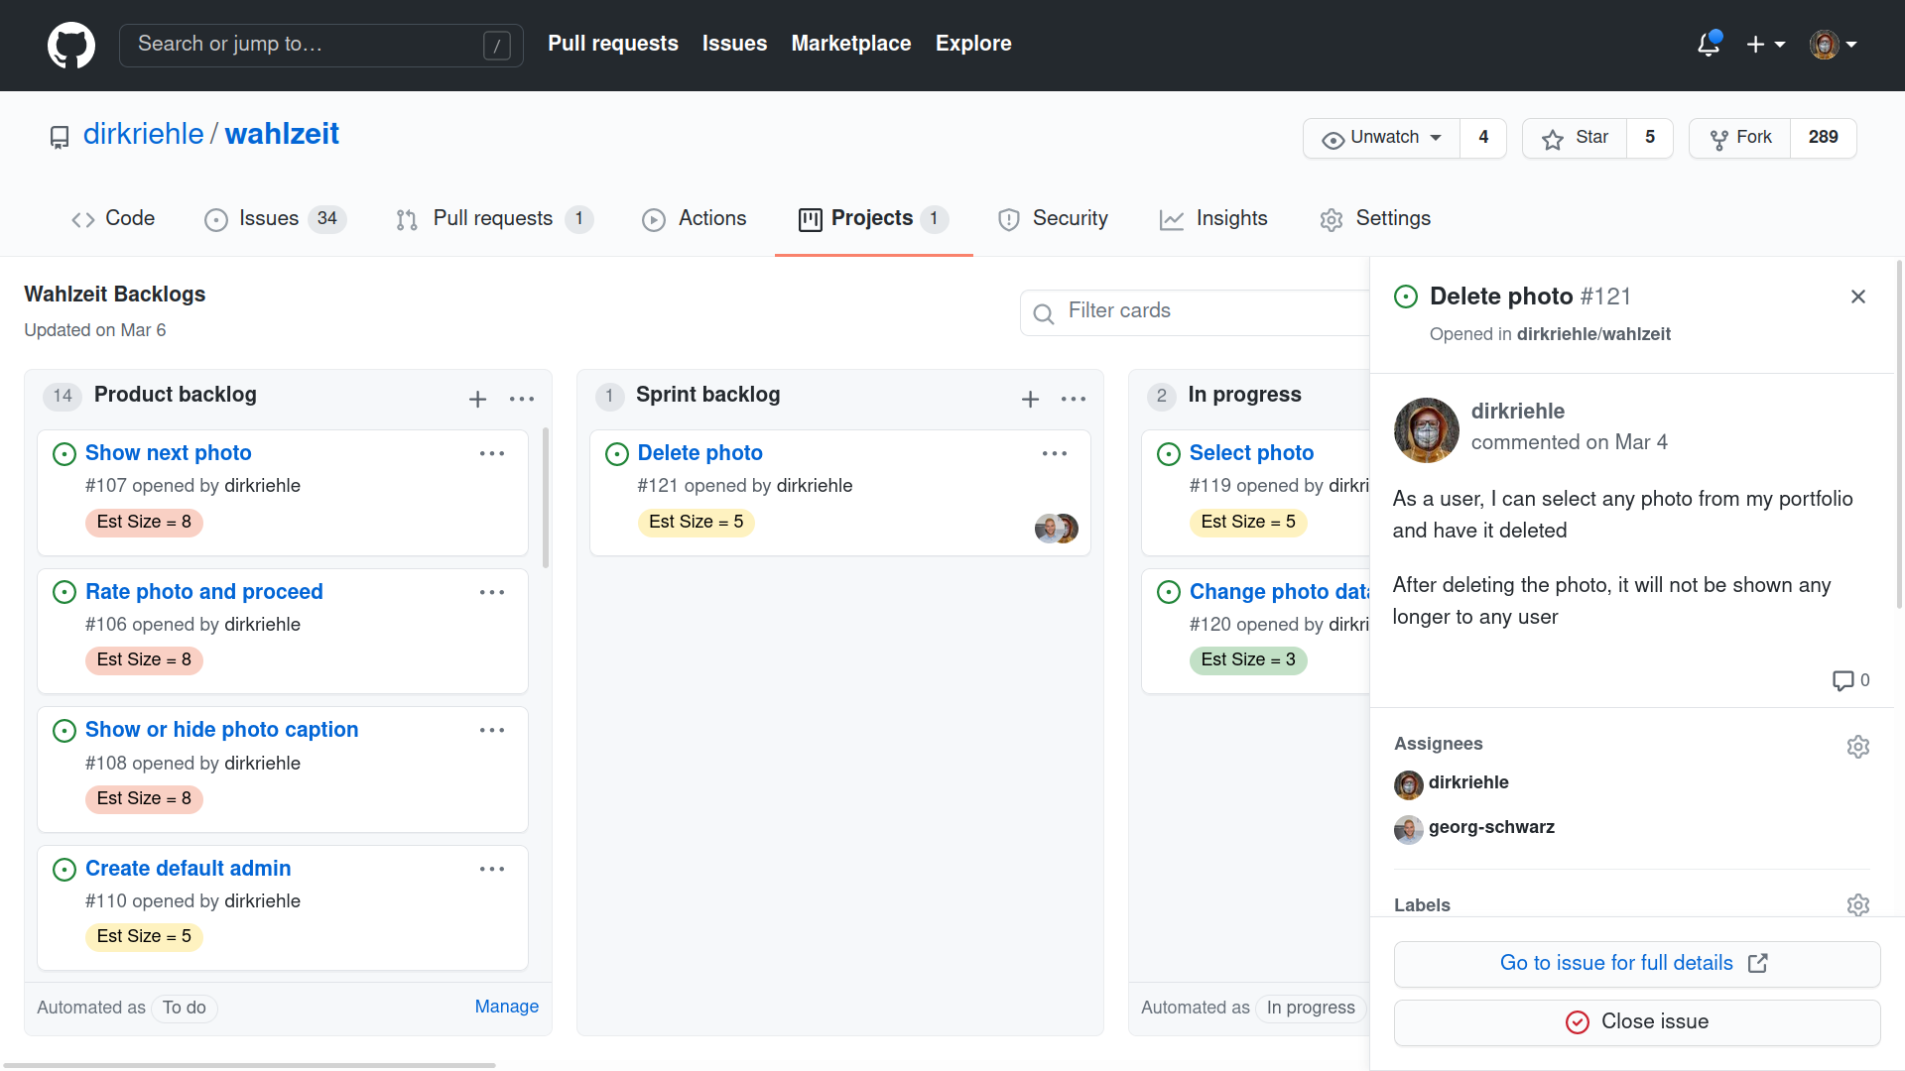
Task Planning / Assigning Backlog Entries

Slide 23
4. Committing Code

Slide 24
Use Only One Account Per Student
Please use only one account, the one you list in the planning documents
  If you find that you used multiple accounts, please tell us about it

Slide 25
Identify Co-authors When Pair Programming
If you are pair programming, give credit when committing
  Add trailing Co-authored-by to commit message
  Use your GitHub no-reply email address if you want to keep your email private
dirk@host$ git commit -a -m "Fixed problem Co-authored-by stefan-buchner@users.noreply.github.com"

Slide 26
5. Planning Documents

Slide 27
Planning Documents Set-up
Strategic planning uses Google Sheets
  We will share a folder with the planning documents with you
  Please check everyone has access
Wahlzeit / Flowers example
  Planning artifacts: http://bit.ly/3qitBF1

Slide 28
Planning Documents
# | Artifact Name | Artifact Purpose
1 | Project data | Provides basic project data
2 | Project team | Shows project team and static roles, if any
3 | Team contract | Shows team contract
4 | Role assignments | Tracks role assignment
5 | Product goal | Proides product vision and project mission
6 | Product glossary | Provides domain terminology of project
7 | Mid-project release tracking | Tracks mid-project release sprints
8 | Final project release tracking | Plans and tracks final project release sprints
10 | Definition of done | Provides decision criteria for “done”
11 | Documentation | Provide links to documentation of product
12 | Bill of materials | Lists all third-party components
13 | Planning poker | Provides simple tool for planning poker

Slide 29
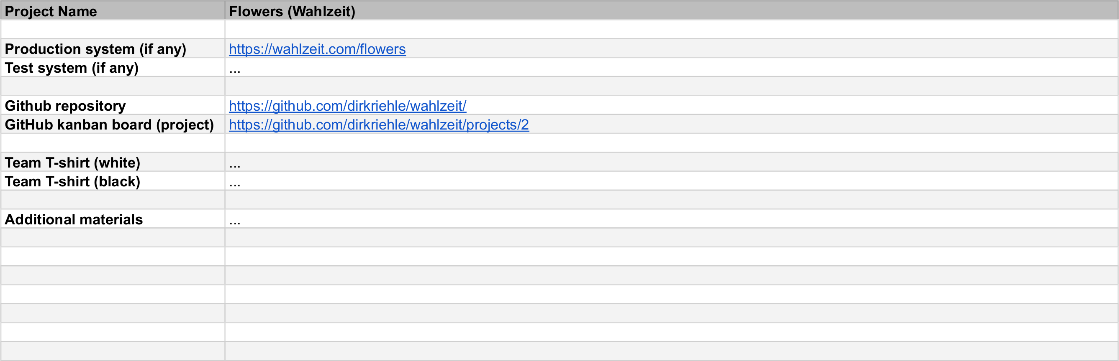
1. Project Data

Slide 30
1. Project Data (Explanation)
Definition
  A collection of relevant (starting point) links
Purpose
  To simplify navigation
Production and system
  Deployment scenarios depend on project
GitHub repository
  Required
CI tooling
  Optional

Slide 31
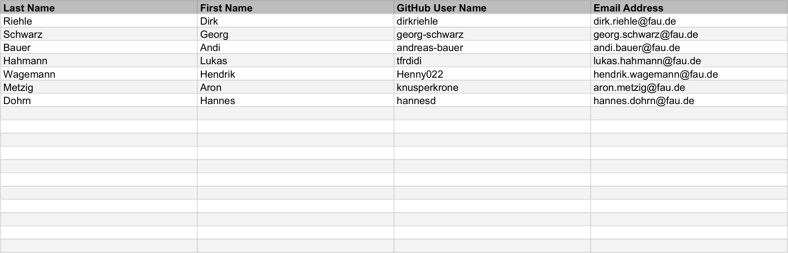
2. Project Team

Slide 32
2. Project Team (Explanation)
Definition
  The list of team members and their contact information
Purpose
  To make it easy to contact individuals or the whole team
Pragmatics
  Feel free to add other information, e.g. Skype ID

Slide 33
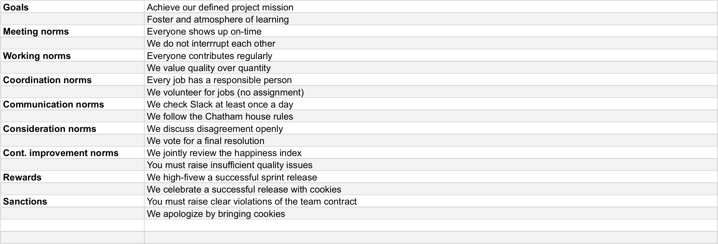
3. Team Contract

Slide 34
3. Team Contract (Explanation) [1]
Definition
  A uniform agreement of the team as to which goals, norms, rewards, and sanctions they play by
Purpose
  To have a defined and agreed-upon way of operating as a team
[1] https://oss.cs.fau.de/teaching/course-resources/student-team-contract/

Slide 35
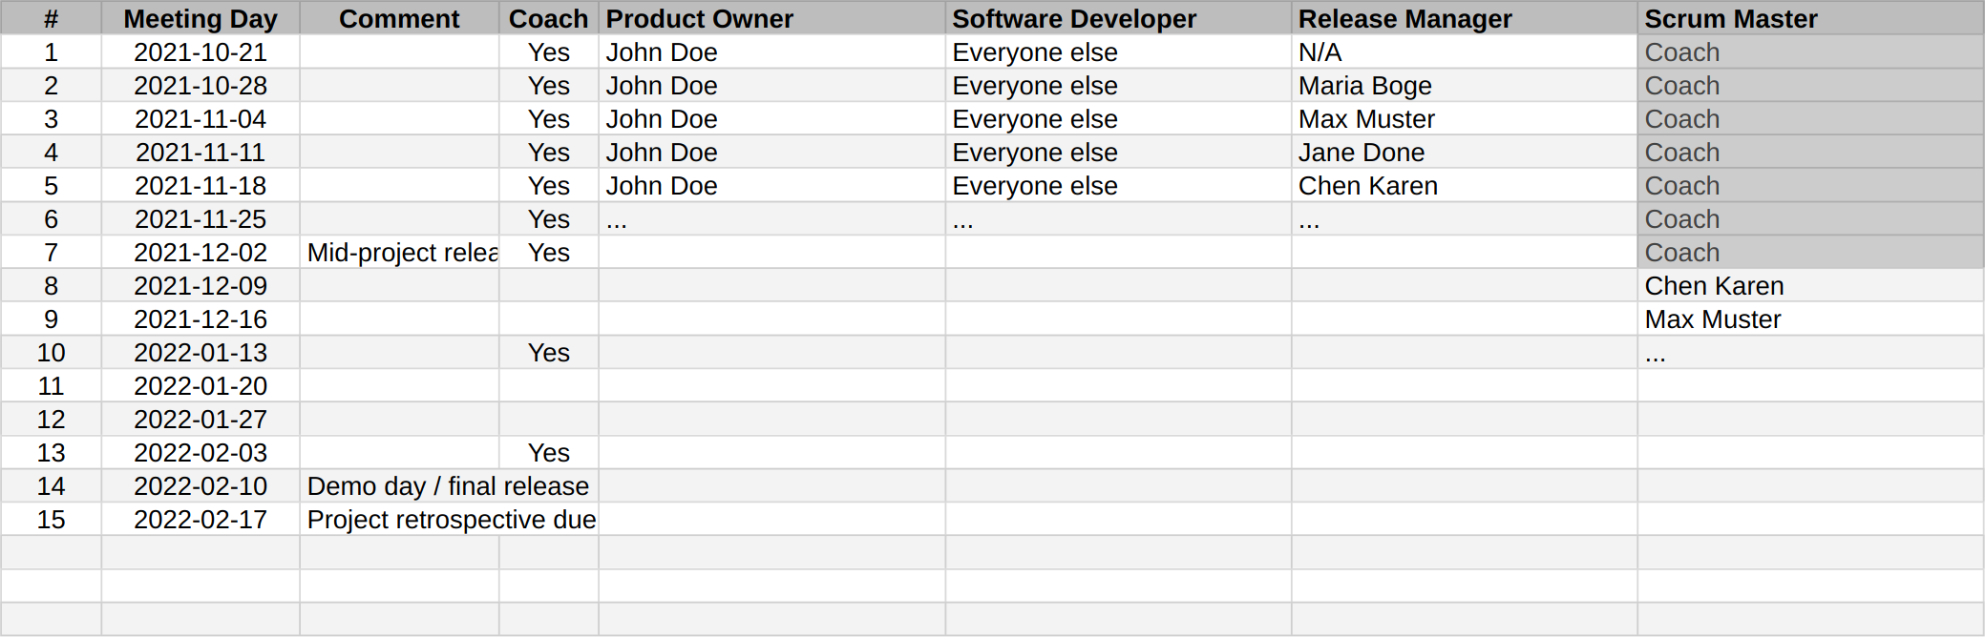

4. Role Assignments

Slide 36
4. Role Assignments (Explanation)
Definition
  A week-by-week assignment of roles to team members
Purpose
  To have a plan and history of role assignments so everyone knows their job
Pragmatics
  Please plan out the project at start of course
  Feel free to add roles beyond the four required ones
Use the same week numbers as in the Course schedule
  Week 1 starts with the first lecture
  Week 1 also starts the first sprint

Slide 37
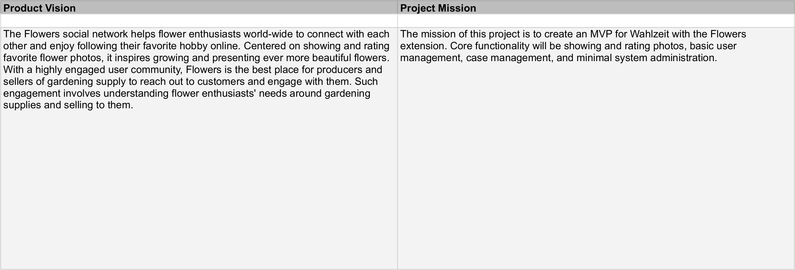
5. Product Goal

Slide 38
5. Product Goal (Vision and Mission)
Definition of product vision
  A product vision communicates
    The main purpose and core functionality of the product
    The value the main stakeholders receive
  It is inspiring, timeless, focused and the final arbiter
Definition of project mission
  A project mission summarizes
    What the project wants to achieve
    Within the project time-frame
Purpose
  To succinctly explain product and project
  To guide when prioritizing features

Slide 39
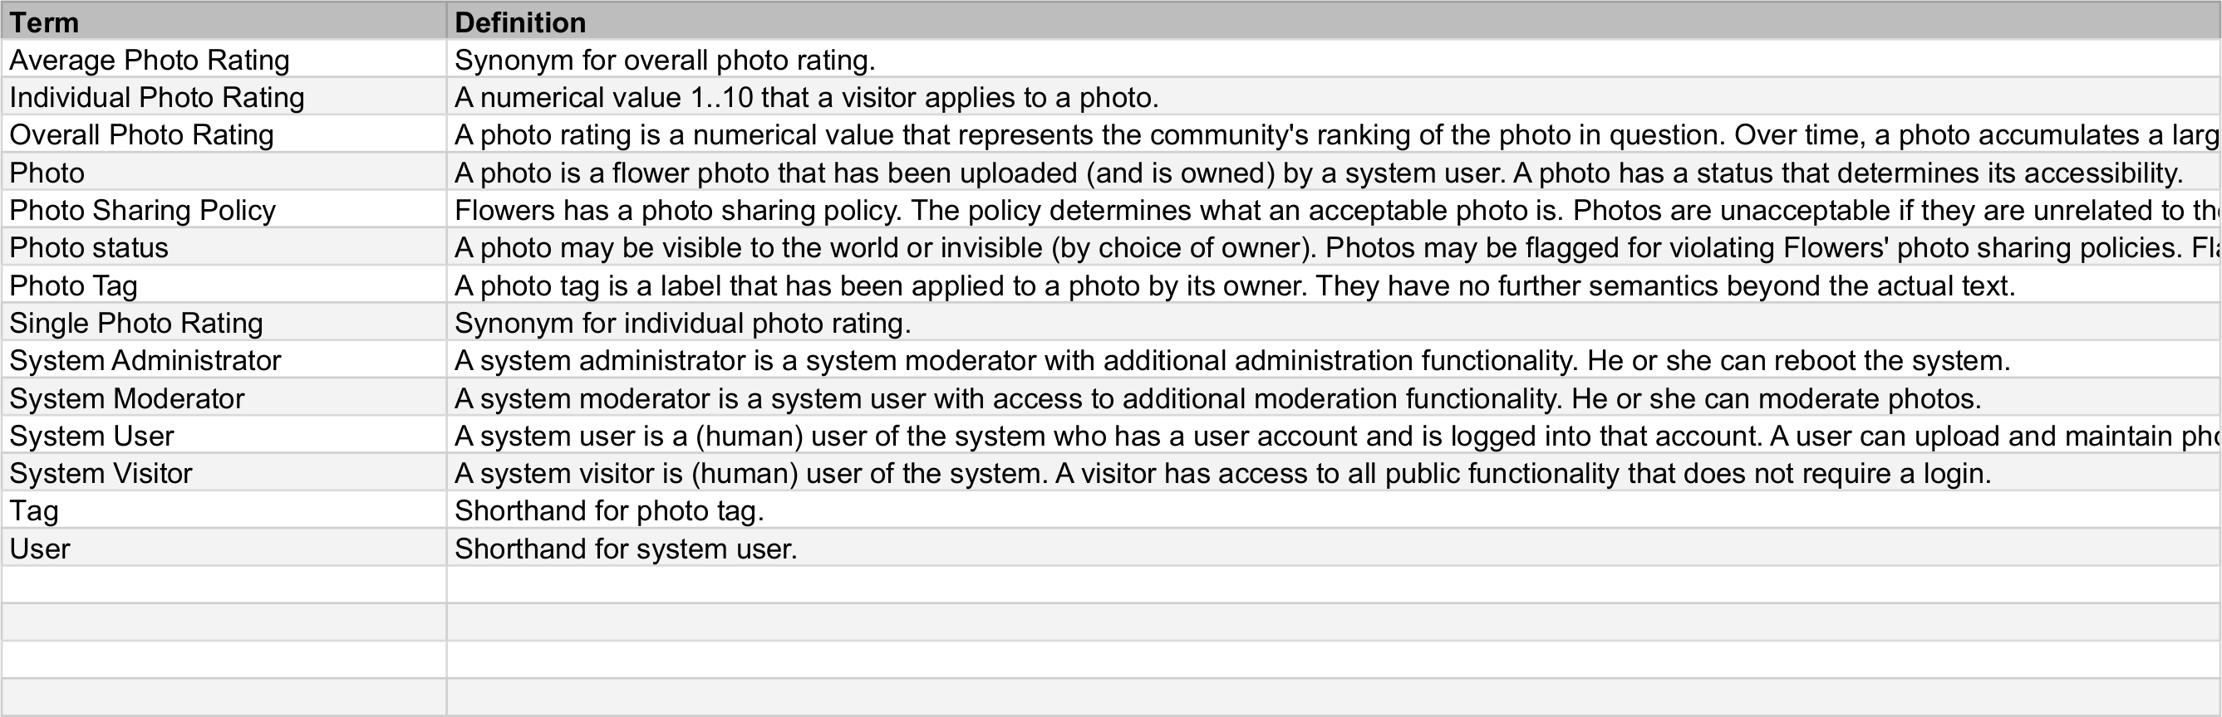
6. Product Glossary

Slide 40
6. Product Glossary (Explanation)
Definition
  Is an alphabetically ordered list of terms and their definition
Purpose
  To provide key domain terminology (shared vocabulary) of project
  Is a simplified form of a domain model accessible to everyone
Term
  A (possibly qualified) noun determining the concept to be defined
Term definition
  The definition of the referenced term
  A base definition is a declarative statement of the form X is a X*
  Other forms of definitions are synonyms, short-hands, etc.

Slide 41
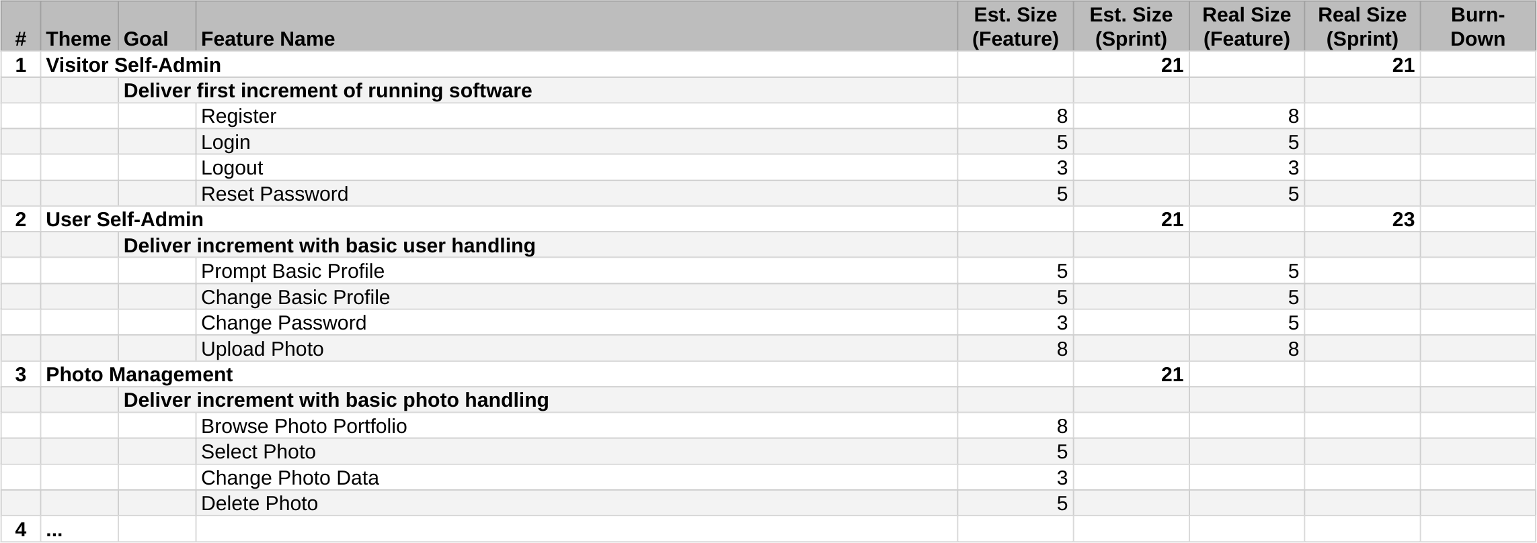
7. Mid-Project Release Tracking

Slide 42
7. Mid-Project Release Tracking (Explanation)
Definition
  A prioritized list of features for a product release
Purpose
  To predict the content of the upcoming product release
Pragmatics
  Has been estimated by developers, validated by historic data
  Is a living document, that is, gets adjusted after each sprint

Slide 43
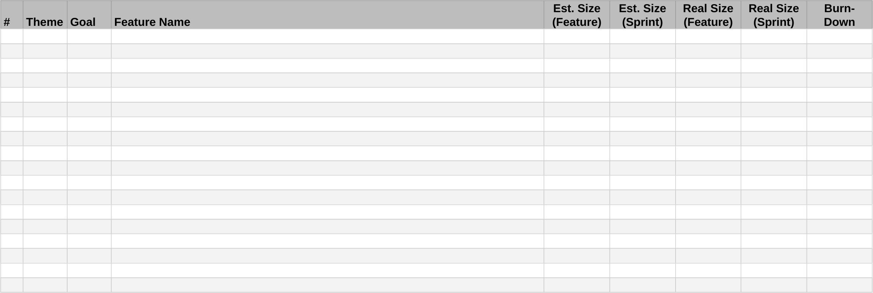
8. Final Project Release Planning and Tracking

Slide 44
8. Final Project Release Planning and Tracking (Explanation)
Like mid-project release tracking, but with added planning

Slide 45
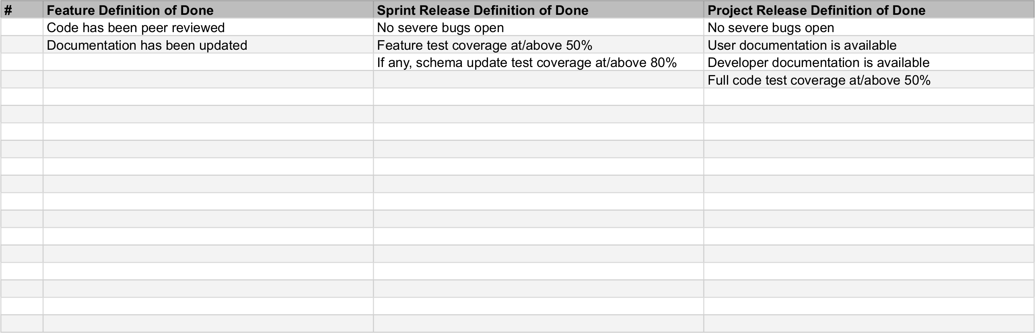
10. Definition of Done

Slide 46
10. Definition of Done (Explanation)
Definition
  Is a check list of decision criteria to determine status of “done”
Purpose
  To be consistent about what “done” means
Pragmatics
  Definitions of “done” (DoD) require team consensus
  There are many such decisions, hence many DoDs needed
  At a minimum, at the proper time, the team should have a
    DoD for features
    DoD for sprint release
    DoD for product release

Slide 47
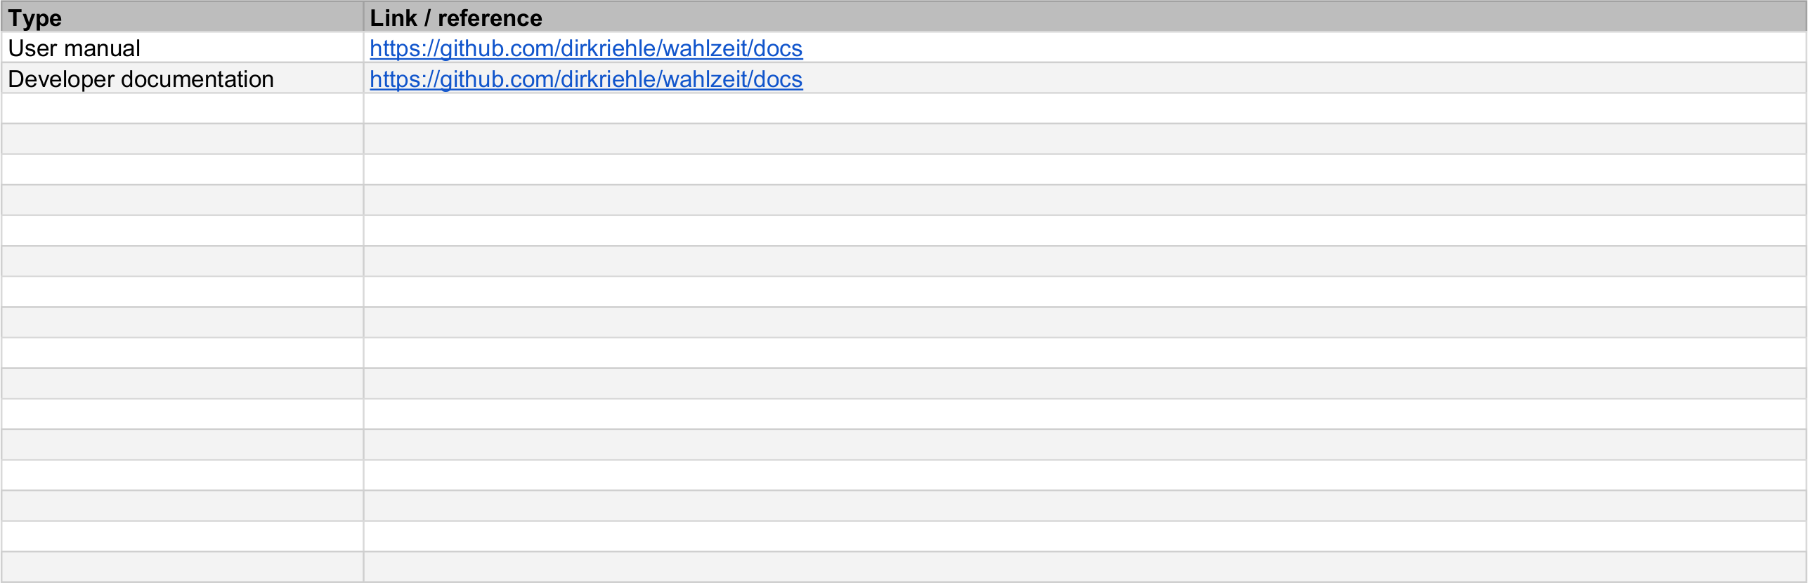
11. Documentation

Slide 48
11. Documentation (Explanation)
Definition
  The product documentation (where to find what)

Slide 49
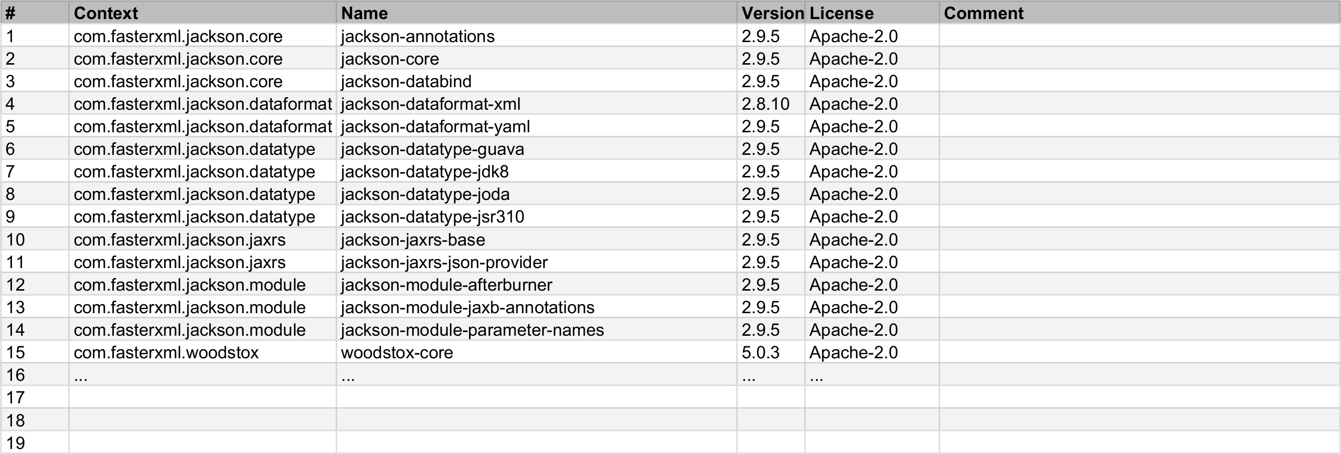
12. Bill of Materials

Slide 50
12. Bill of Materials (Explanation)
Definition
  A list of items (“materials”) included in the project
  Items typically mean open source libraries
Purpose
  To maintain an overview of “what’s the box”
Pragmatics
  Please lists all third-party components used by the product
  List only those used directly; no need to recursively unpack
  In case of open source components, also list their license

Slide 51
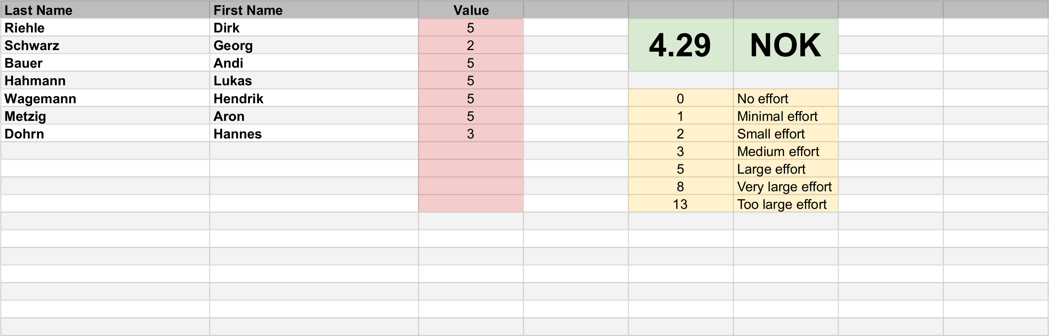
13. Planning Poker

Slide 52
6. Impediments Backlog

Slide 53
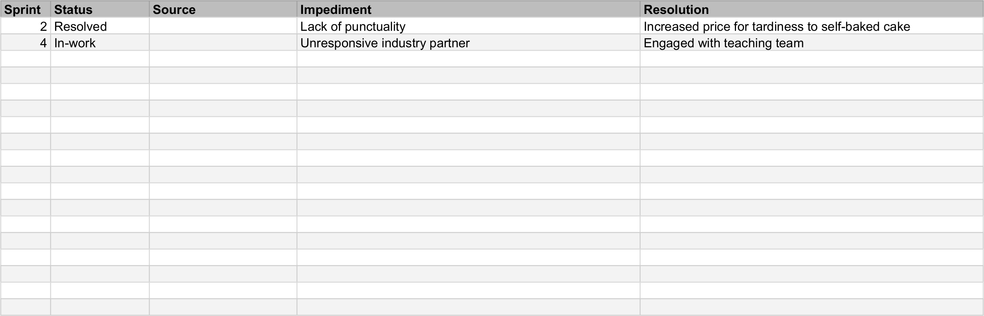
9. Impediments Backlog

Slide 54
9. Impediments Backlog (Explanation)
Definition
  A list of current and historic impediments to process
Purpose
  To know at any time the current impediments
  To see whether any impediments keep recurring
Pragmatics
  It names the Scrum master responsible for resolution
  It provides the solution found, if any

Slide 55
7. Weekly Checklist

Slide 56
Weekly Checklist for Artifacts
Software product
  Tagged, testable, deployable software code base and product
Planning documents
  Clean project board, release planning, additional information
Process improvement
  Impediments documented; happiness index survey taken

Slide 57
Summary
Code repository
Issues
Project board
Committing code
Planning documents
Impediments backlog
Weekly checklist

Slide 58
Thank you! Questions?
dirk.riehle@fau.de – https://oss.cs.fau.dedirk@riehle.org – https://dirkriehle.com – @dirkriehle
DR

Slide 59
Legal Notices
License
  Licensed under the CC BY 4.0 International license
Copyright
  © 2010-2021 Dirk Riehle, some rights reserved

